Slide 1
Data Analysis of Hardware Sales
Atliq Hardwares (imaginary company) is one of the leading computer hardware producers in India and well expanded in other countries too.

Slide 2
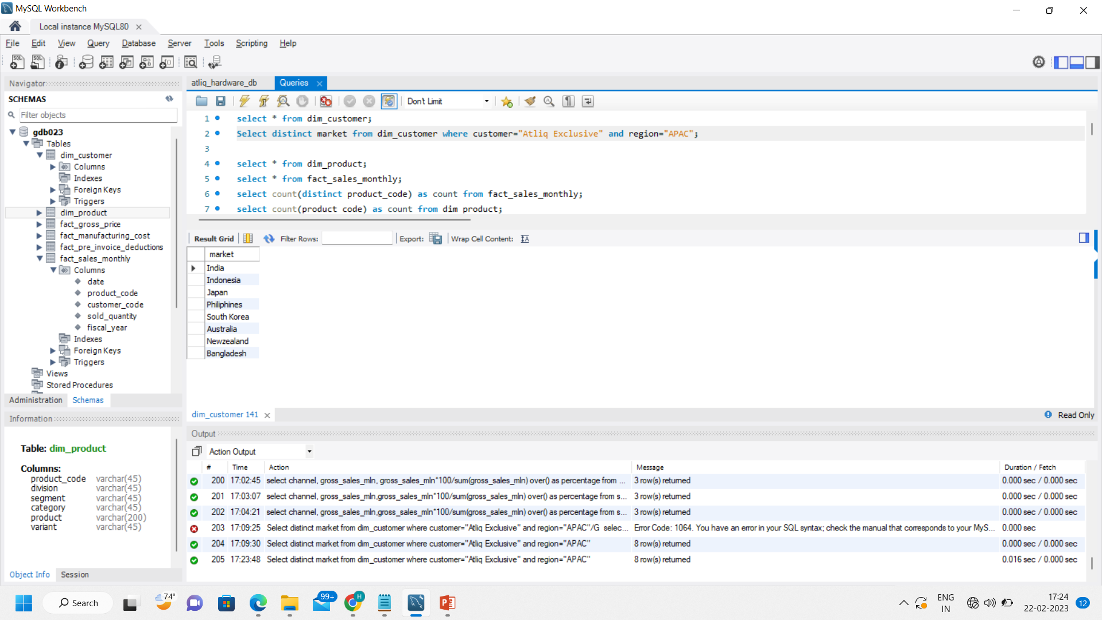
Request.1 - Provide the list of markets in which customer "Atliq Exclusive" operates its business in the APAC region.
Insight.1 – This are the markets in which customer “Atliq Exclusive” operates its business in the APAC region.

Slide 3
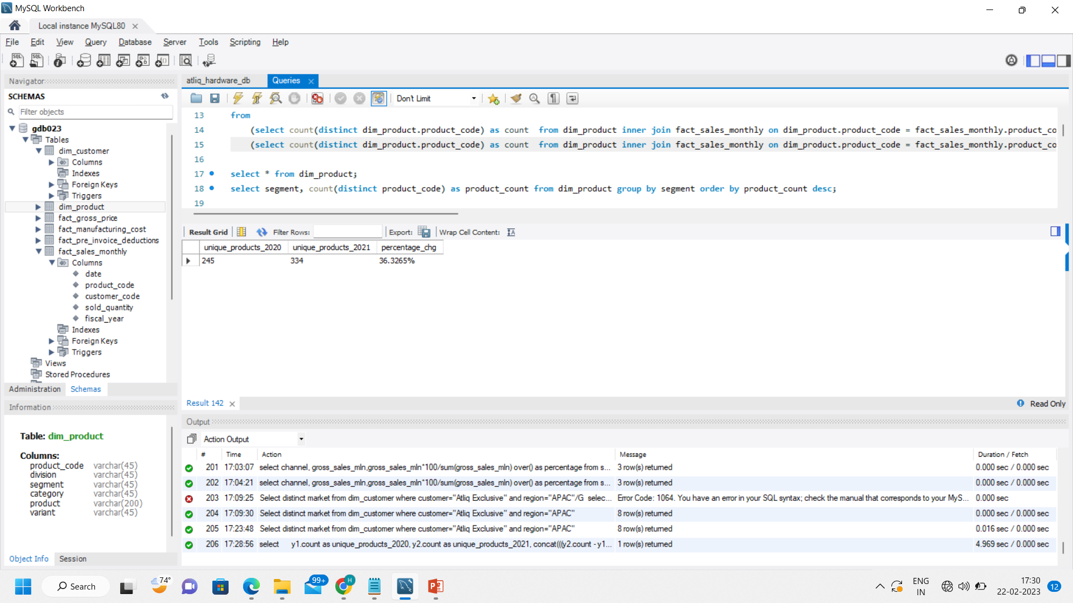
Request.2 - What is the percentage of unique product increase in 2021 vs. 2020?
Insight.2 – There is 36.33 % increase in unique product from 2020 to 2021.

Slide 4
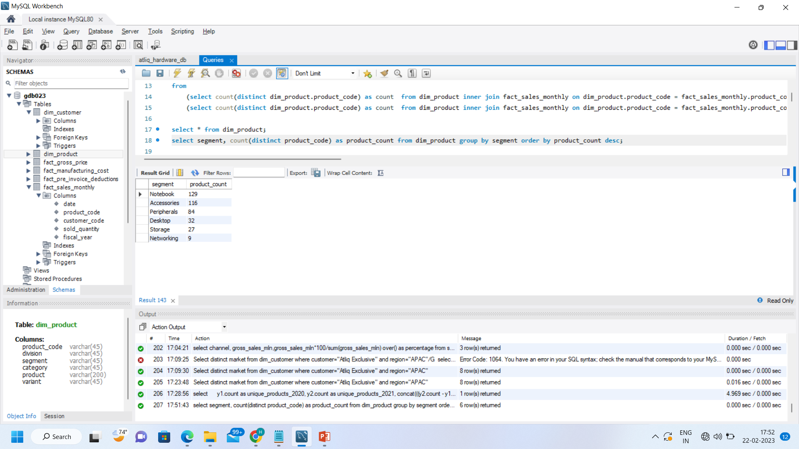
Request.3 - Provide a report with all the unique product counts for each segment and sort them in descending order of product counts.
Insight.3 – ‘Notebook’ has highest product count.

Slide 5
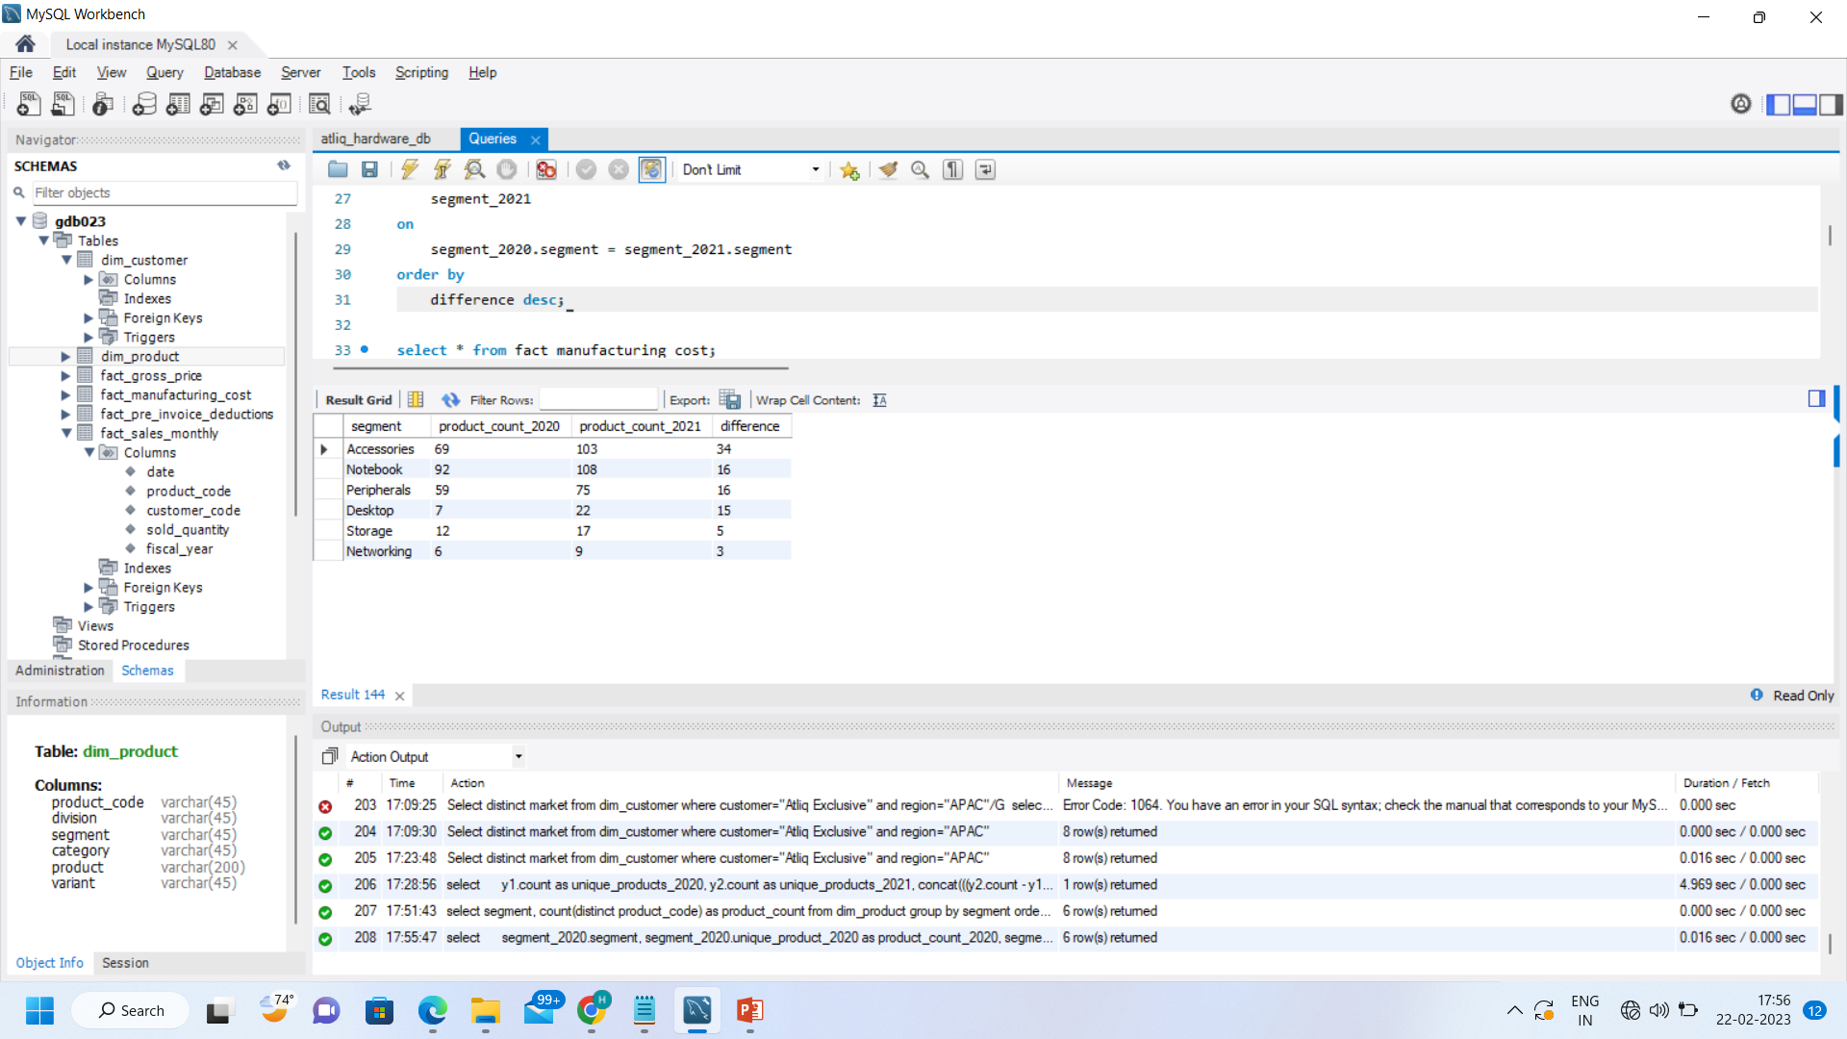
Request.4 - Which segment had the most increase in unique products in 2021 vs 2020?
Insight.4 – The ‘Accessories’ segment had the highest increase in unique products from 2020 to 2021.

Slide 6
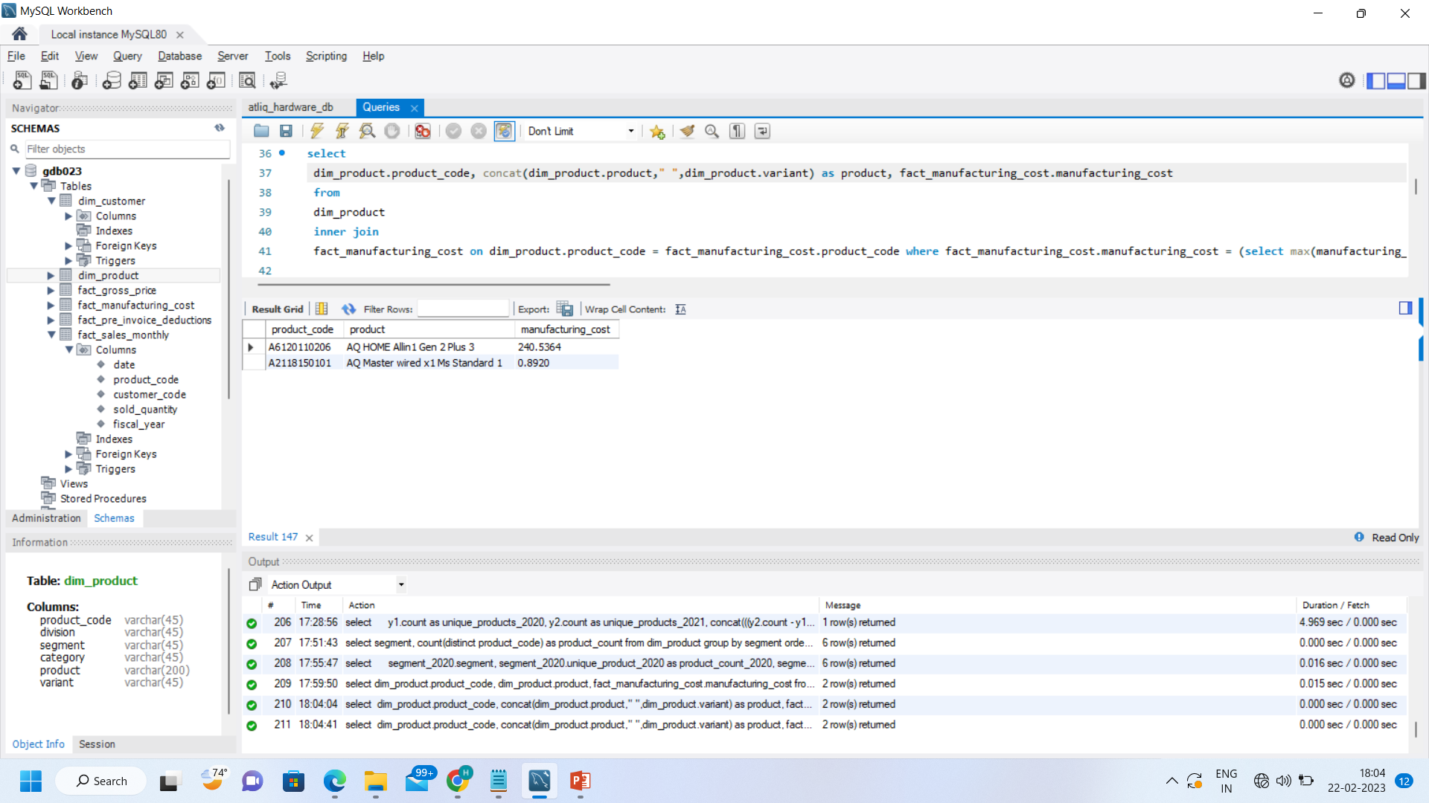
Request.5 - Get the products that have the highest and lowest manufacturing costs.
Insight.5 – ‘AQ HOME Allin 1 Gen 2 Plus 3’ have the highest while ‘AQ Master wired x1 Ms Standard 1’ have the lowest manufacturing cost.

Slide 7
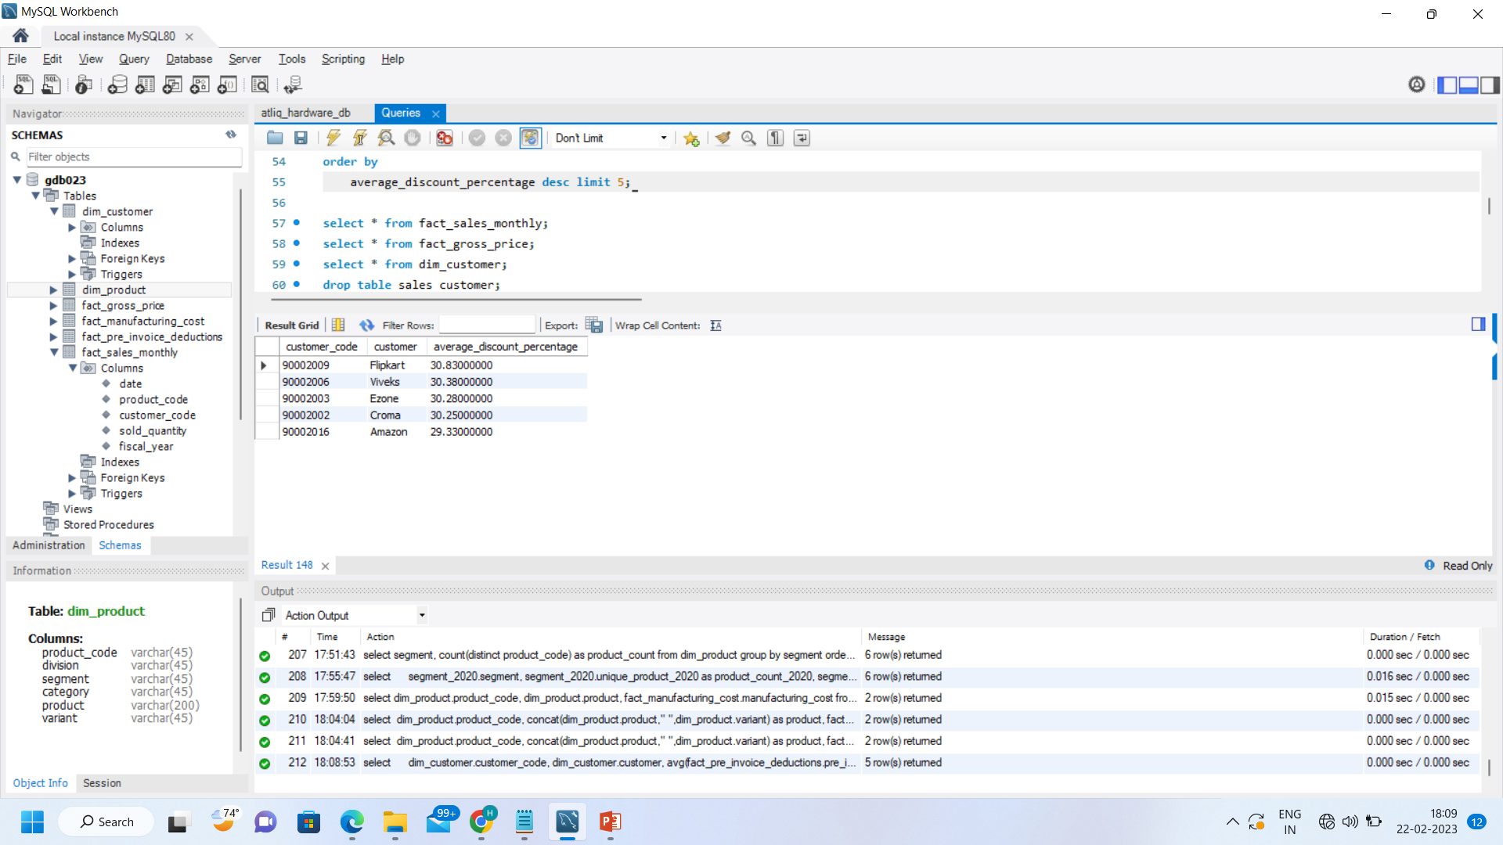
Request.6 - Generate a report which contains the top 5 customers who received an average high pre_invoice_discount_pct for the fiscal year 2021 and in the Indian market.
Insight.6 – ‘Flipkart’, ‘Viveks’, ‘Ezone’, ‘Croma’, & ‘Amazon’ are the top 5 customers who received an average high pre_invoice_discount_pct for the fiscal year 2021 and in the Indian market.

Slide 8
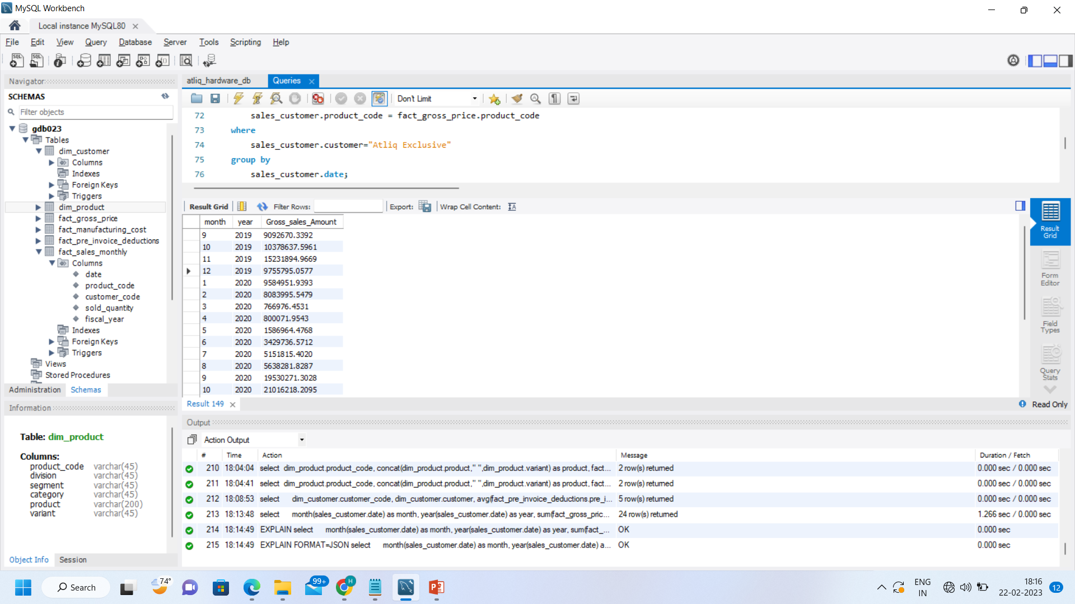

Request.7 - Get the complete report of the Gross sales amount for the customer “Atliq Exclusive” for each month. This analysis helps to get an idea of low and high-performing months and take strategic decisions.
Insight.7 – This is a Monthly report of gross sales for “Atliq Exclusive”.

Slide 9
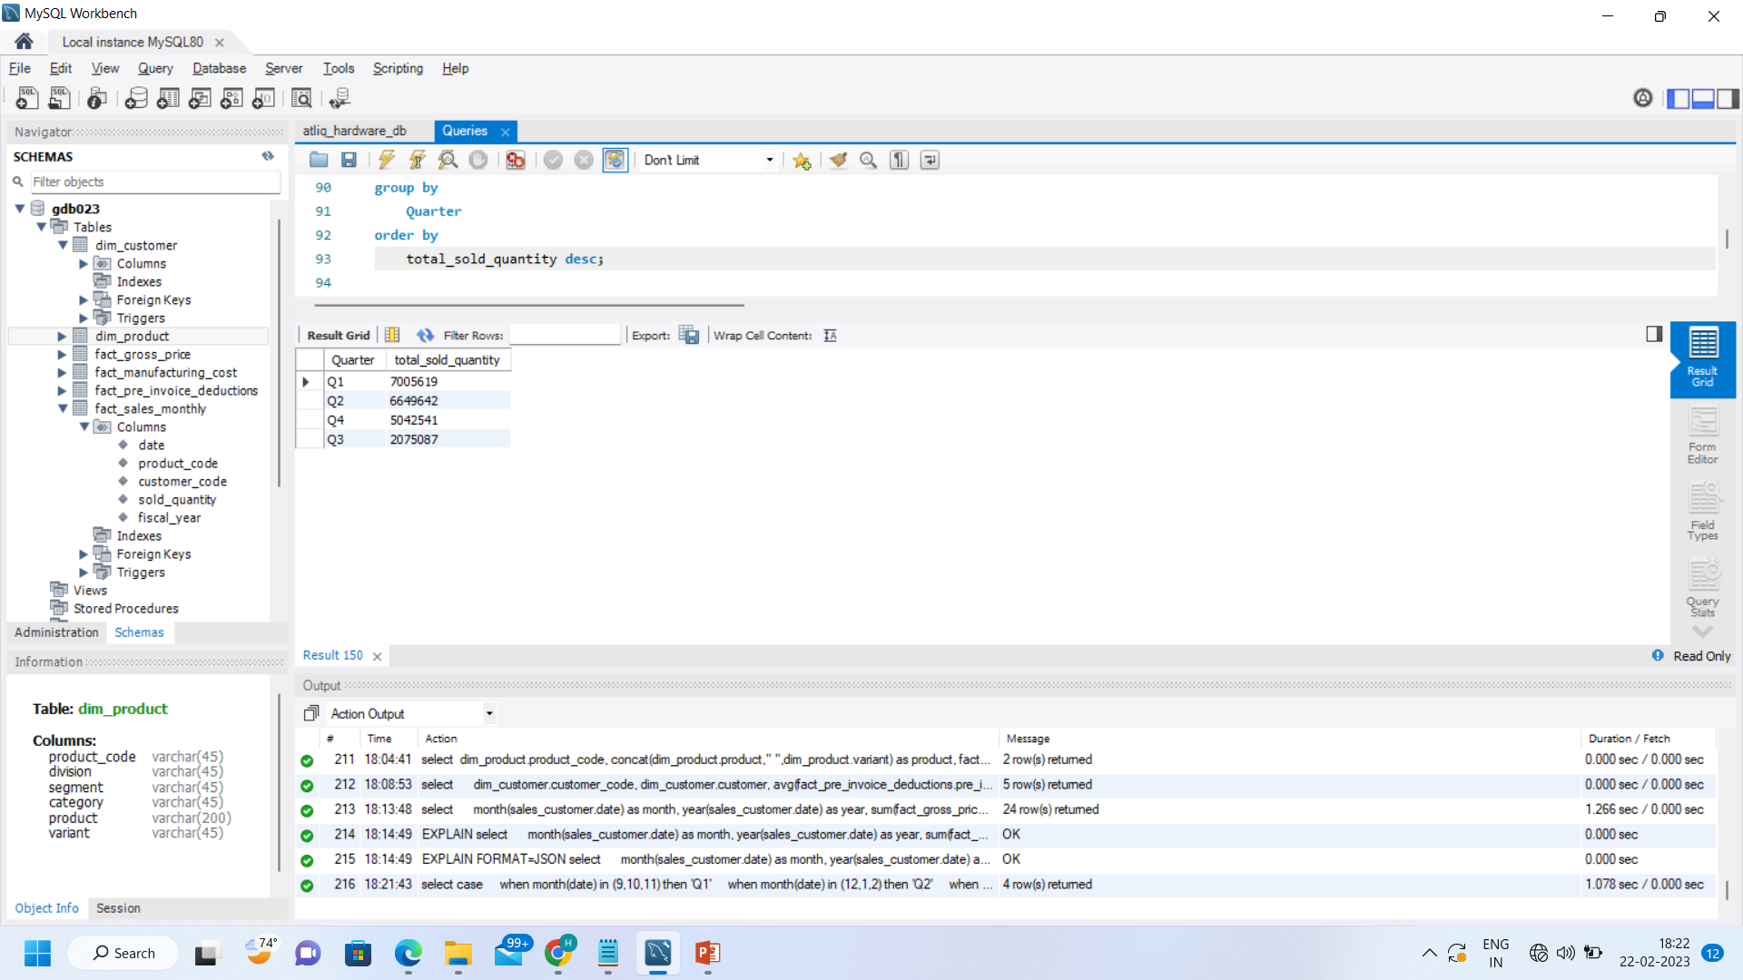
Request.8 - In which quarter of 2020, got the maximum total_sold_quantity?
Insight.8 – ‘Quarter 1’ got the maximum total_sold_quantity.

Slide 10
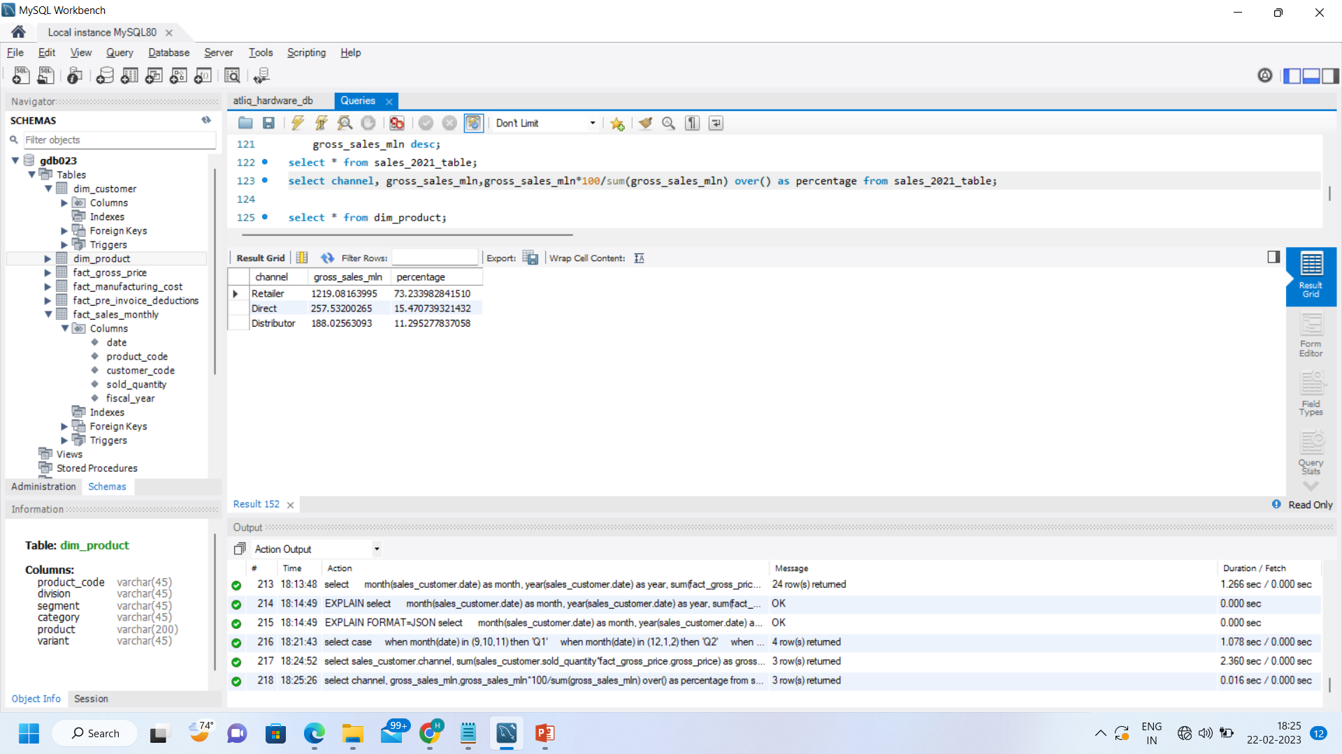
Request.9 - Which channel helped to bring more gross sales in the fiscal year 2021 and the percentage of contribution?
Insight.9 – ‘Retailer’ channel helped to bring more gross sales in the fiscal year 2021 with 73.23 percentage of contribution.

Slide 11
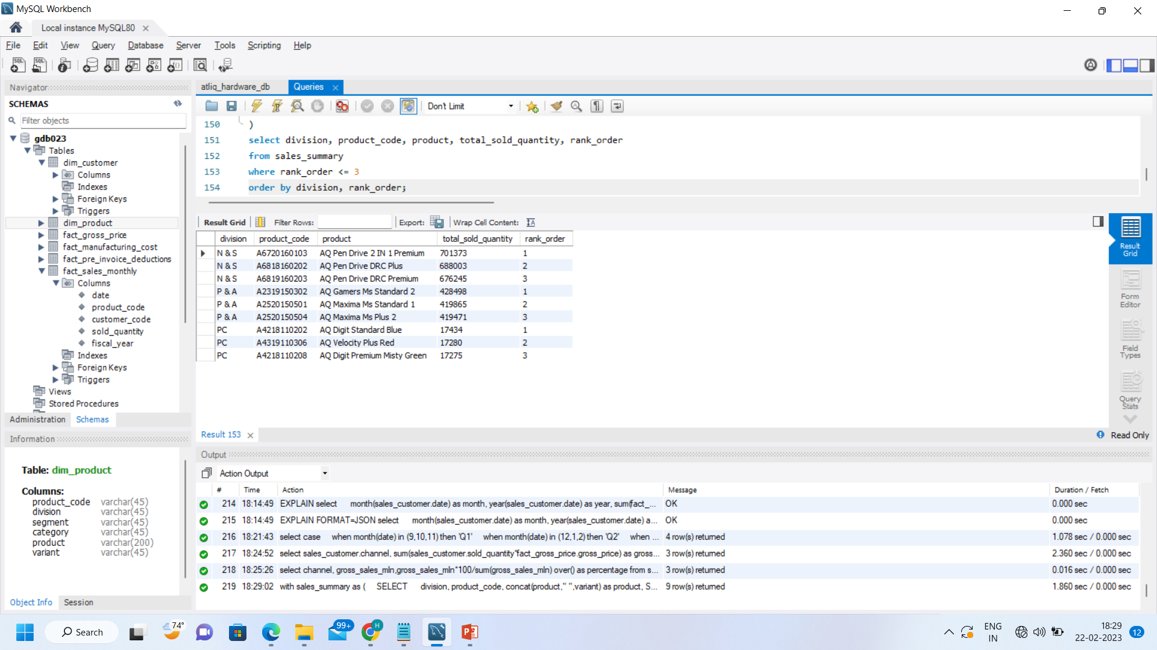
Request.10 - Get the Top 3 products in each division that have a high total_sold_quantity in the fiscal_year 2021?
Insight.10 – This are the top 3 products from each division.

Slide 12
Thank You !

